Slide 1

SEMINAR ON
1
ARTIFICIAL RETINA USING THIN-FILM TRANSISTORS DRIVEN BY WIRELESS POWER SUPPLY

Slide 2
Abstract
2
We are developing artificial retinas using poly-Si thin-film transistors (TFTs), which is suitable for the epiretinal implant on the curved human eyeballs. In this study, we have evaluated the wireless power supply to the artificial retinas using poly-Si TFTs. From simulation, it is found that the transmission efficiency can be 0.43%
currently. This value should be improved but acceptable because our artificial retina consumes very low power.

Slide 3
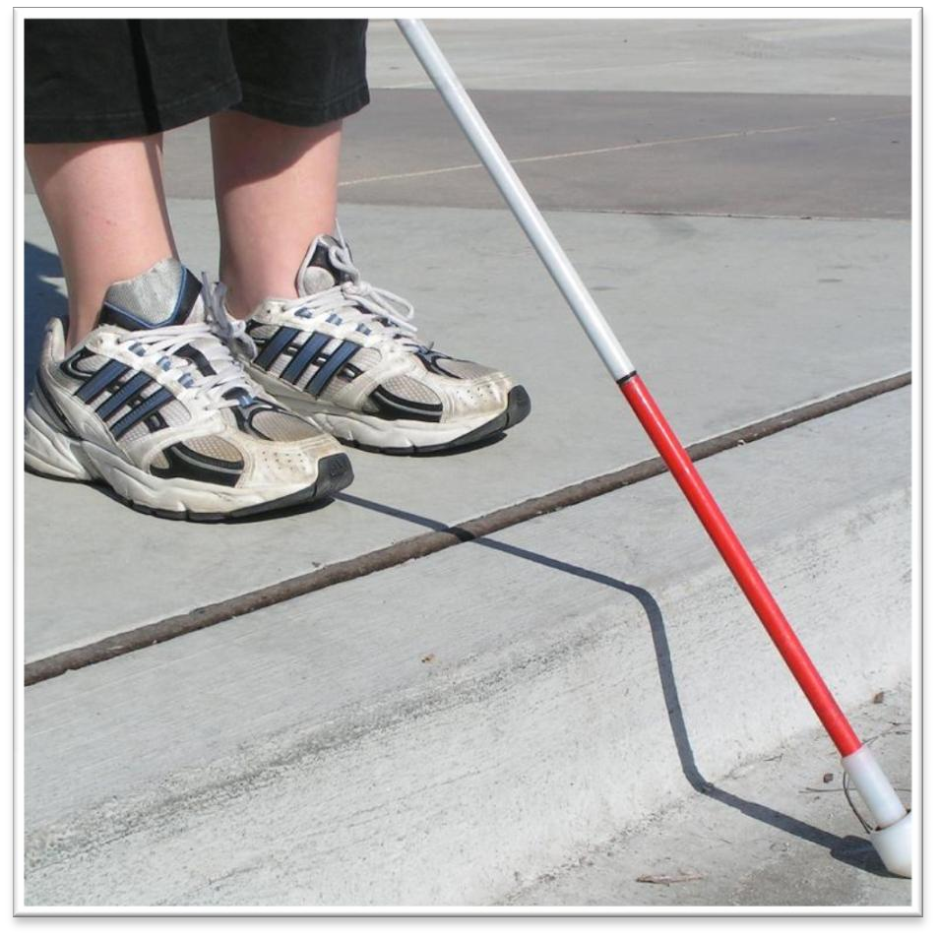
Cause of Blindness
3
Damage to:
Clear structures in the eye, that
allow the light to pass through.
The nerves within the eye.
The Optic nerve
Brain
BLINDNESS

Slide 4
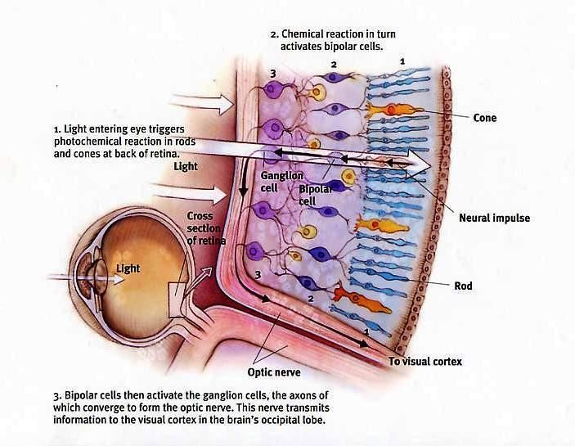
The Retina
4

Slide 5
Diseases of Eye
5
Retinitis Pigmentosa
Macular Degeneration
Hereditary genetic disease.
Degeneration of the retina
Gradually progress towards center of eye.
Tunnel vision results.
Genetically related.
Cones in macula region
degenerate.
Loss or damage of central vision.
Common among aged people.

Slide 6
Artificial Thin-Film Transistor Retina
6
Recovers the sight sense for sight-handicapped people.
Electronic Photo devices | and | circuits | substitutes | deteriorated
photoreceptor cells. Implanted inside the eyes. Implanting classified into | two | types: | Epiretinal | implant and
Subretinal implant .
Thin-Film Transistors, substrates.
fabricated
on transparent
and flexible

Slide 7
Artificial Thin-Film Transistor Retina
7
Implantable microelectronic retinal prosthesis.
The first application of an implantable stimulator for vision restoration was developed by Dr S. Brindley and Lewin in 1968.

Slide 8
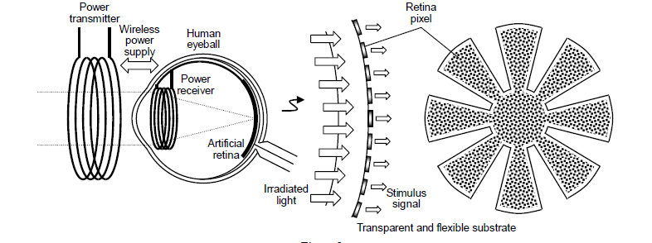
Retinal Implantation
8
Epiretinal implant
•They sit in the inner surface of the retina.
•They bypass a large portion of the retina.
•Provides visual perception to individuals
•The implants receive input from a camera.

Slide 9
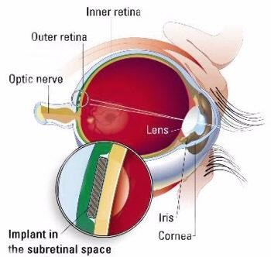
Retinal Implantation
9
Subretinal implant
•Subretinal implants
surface of the retina.
sit on the outer
•Directly stimulates the retinal cells
•Replace damaged rods and cones by Silicon plate carrying 1000’s of light- sensitive micro photodiodes each with a stimulation electrode.

Slide 10
Retinal Implantation
10
The epiretinal implant have high image resolutions.
Stimulus signal can be directly conducted to neuron cells .
Here living retinas are not seriously damaged.
The input to the Epiretinal Implant is more easily controlled

Slide 11
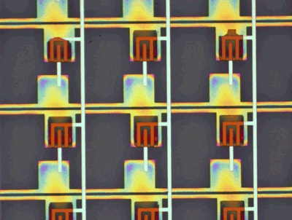
Fabrication of Thin-Film Transistor
11
Optical microscopic image of the 100 ppi organic thin-film transistor

Slide 12
Fabrication of Thin-Film Transistor
12
ION Doping Techniques:
5% PH₃. or 5% B₂H6 diluted by hydrogen is used for the doping gas .
RF plasma is formed in the chamber by RF power with a frequency of
13.56 MHz.
Ions from discharged gas are accelerated electrode by an extraction and an acceleration electrode.

Slide 13
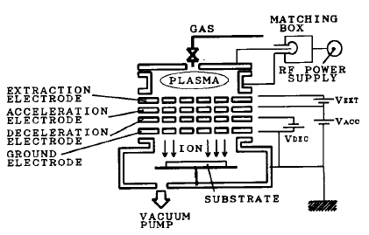
Fabrication of Thin-Film Transistor
13
Then implanted into the substrate.
Impurities can be implanted over the entire 300 mm square substrate.
Maximum accelerating voltage of over 110 KeV which is sufficient for implanting impurities through the 150nm SiO₂ gate insulator.

Slide 14
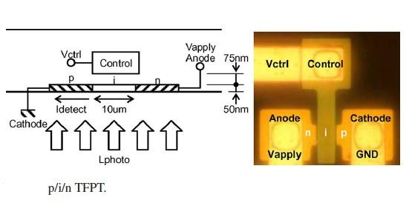
p/i/n Thin-Film Photo Transistor
14
They are used in photo sensor applications.
Here thin-film photo devices are integrated with low-temperature poly-Si
thin-film transistors.
The p/i/n TFPT must be illuminated from the backside of the glass substrate because the control electrode is usually formed using an opaque metal film.

Slide 15
15
WIRELESS POWER SUPPLY USING INDUCTIVE
COUPLING
Inductive coupling of magnetic field
Electrical energy can be easily converted to magnetic energy and back using conductive coil
Traditionally, a pair of inductive coils are used
The secondary coil can be located within the eye and the primary coil external to the eye.
Problems:
first problem is difficulty in placing a large receive coil inside the eye.
complicated surgical procedure

Slide 16
16
WIRELESS POWER SUPPLY USING INDUCTIVE
COUPLING
Major challenge in implementing a wireless power
Large separation between the coils
Constant relative motion between the primary and secondary coils.
Reduction in power transfer to the device.
In order to overcome these problems,
Use of an intermediate link
The secondary coil is located under the sclera (eye wall) and is connected to the implanted device via electrical wires which are embedded under the wall of the eye.
The transmit coil is placed at the back of the ear.

Slide 17
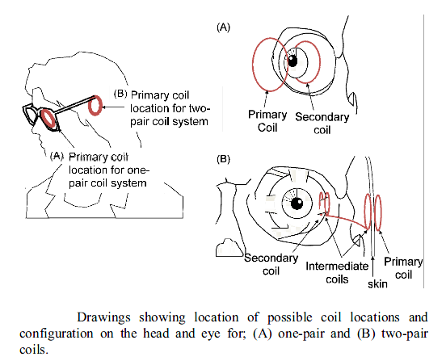
17
WIRELESS POWER SUPPLY USING INDUCTIVE
COUPLING
Intermediate coils are positioned with one end on the sclera over the receive coil and the other end under the skin beneath the transmit coil.
To increase the power transfer efficiency compared to a one-pair coil system.

Slide 18
Working
18
Vpp of the ac voltage source is 10 V, and the frequency is 34 kHz, which is a resonance frequency
The material of the induction coil is an enameled copper wire, the diameter is 1.8 cm, and the winding number is 370 times.
The power receiver also consists of an induction coil, which is the
same as the power transmitter and located face to face.
The diode bridge rectifies the ac voltage to the dc voltage, and the Zener diodes regulate the voltage value.
The supply system is in principle very simple to implant it into
human eyeballs

Slide 19
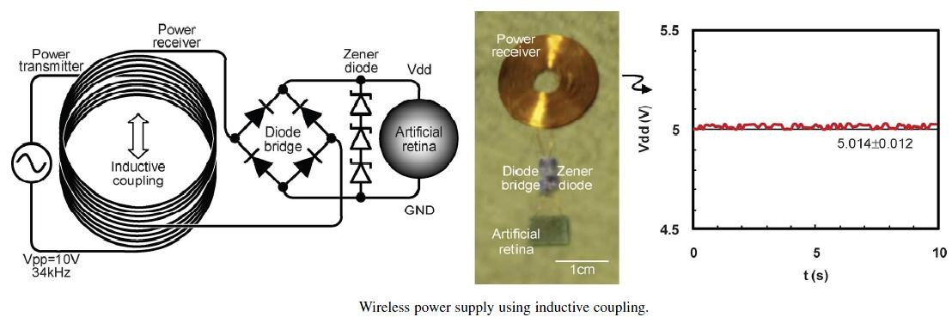
Working
19

Slide 20
20
ARTIFICIAL RETINA USING THIN-FILM
TRANSISTORS
The retina array includes matrix-like multiple retina pixels.
The photo transistor is optimized to achieve high efficiency
The field effect mobility and the threshold voltage of the n-type and p-type
poly-Si TFT were 93 cm² V respectively.
-1_{s}-1
, 3.6 V, 47 cm² V
-1_{s}-1
and -2.9 V,
First, the photo transistors perceive the irradiated light (Lphoto) and induce the photo-induced current (Iphoto).

Slide 21
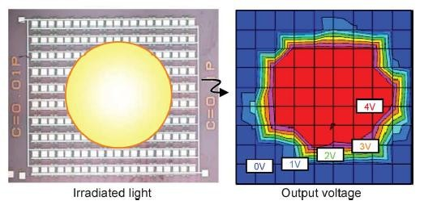
CONCLUSION
21
A pulse signal generator appropriate as photorecepter cells for implementation.
Shows the feasibility to implant the artificial retina into human eyeballs

Slide 22
References
22
Yuta Miura, Tomohisa Hachida, and Mutsumi Kimura, Member, IEEE , “Artificial Retina Using Thin-Film Transistors Driven by Wireless Power Supply” IEEE SENSORS JOURNAL, VOL. 11, NO. 7, JULY 2011.
M. Kimura, Y. Miura, T. Ogura, S. Ohno, T. Hachida, Y. Nishizaki, T. Yamashita, and T.Shima, “Device characterization of p/i/n thin-film phototransistor for photosensor applications,” IEEE Electron Device Lett., vol. 31, no. 9, pp. 984–986, 2010.
Satoshi Inoue, Minoru Matsuo, Tsutomu Hashizume, Hideto Ishiguro, Takashi Nakazawa, and Hiroyuki Ohshima, “LOW TEMPERATURE CMOS SELF-ALIQNED POLY-Si TFTS AND CIRCUIT SCHEME UTILIZING NEW ION DOPING AND MASKING TECHNIQUE “
•
David C. Ng, Chris E. Williams, Penny J. Allen, Shun Bai, Clive S. Boyd, Hamish Meffin, Mark E. Halpern, and Efstratios Skafidas “wireless power delivery for retinal prosthesis” , 33rd Annual International Conference of the IEEE EMBS Boston, Massachusetts USA, August 30 - September 3, 2011
T. Tokuda, K. Hiyama, S. Sawamura, K. Sasagawa, Y. Terasawa, K. Nishida, Y.Kitaguchi, T. Fujikado, Y. Tano, and J. Ohta, “CMOS-based multichip networked flexible retinal stimulator designed for image-based retinal prosthesis,” IEEE Trans. Electron Devices, vol. 56, no. 11, pp. 2577–2585, 2009.

Slide 23


23

